Slide 1
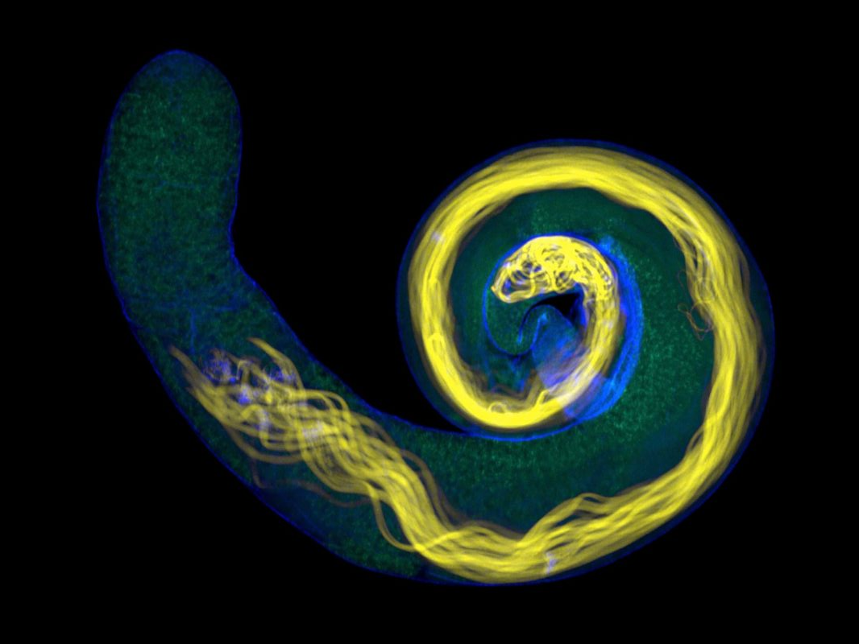
The Role of Monocarboxylate Transporters in Germ Cell Survival in Drosophila Testis
Division of Biosciences
ANAT0015 presentation
Zheheng Fan
Biomedical Sciences BSc.
Supervisor: Dr. Marc Amoyel
Notes:
Today, I am going to introduce my project on monocarboxylate transporters, which mediate the metabolic communication between different stem cell lineages in Drosophila Testis.

Slide 2
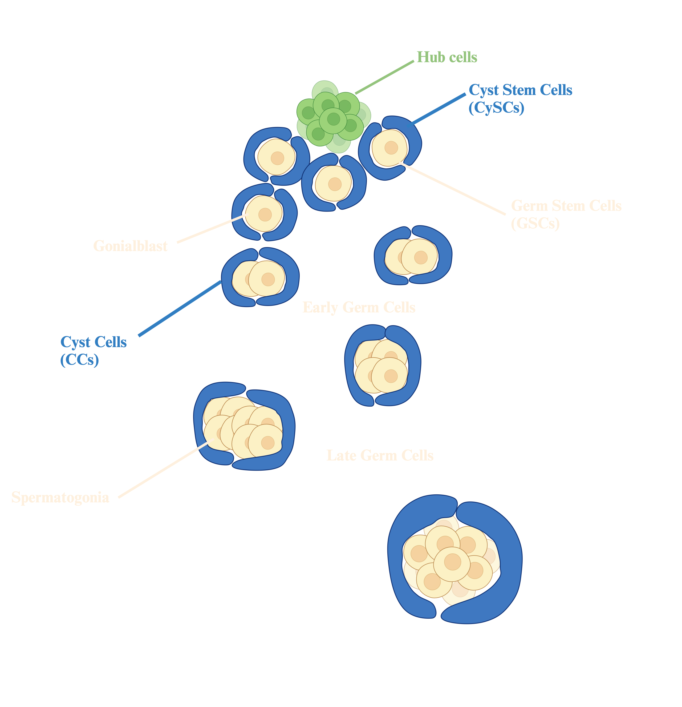
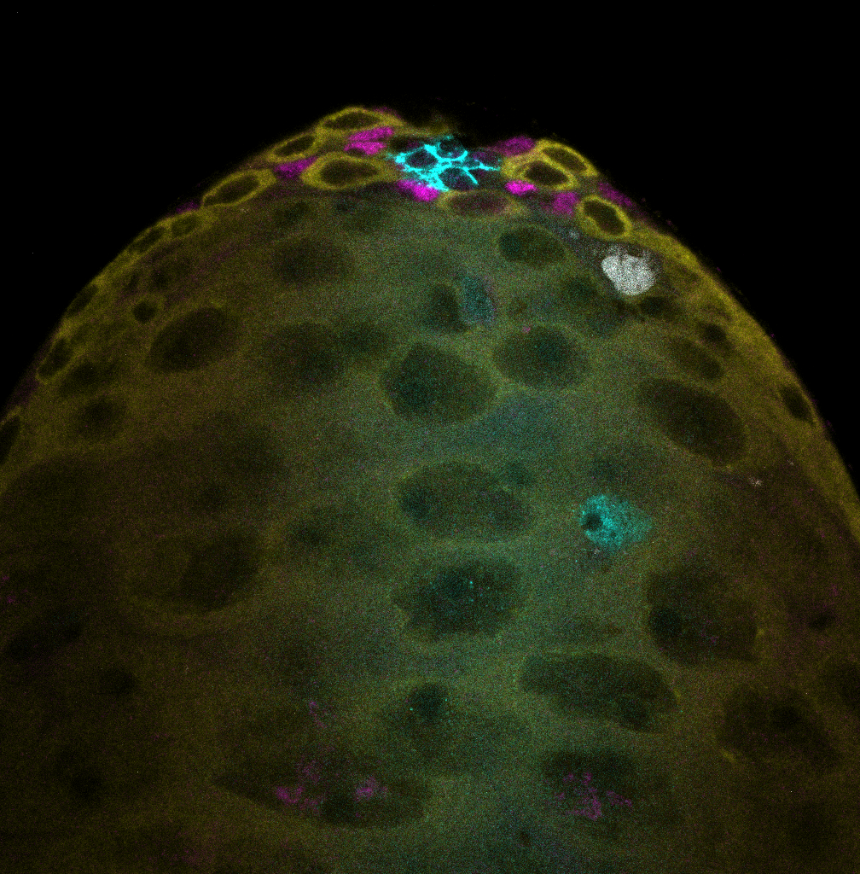
Drosophila Testis as a model to study tissue homeostasis
Hub
Dying Germ Cyst
GSC
CySC
Differentiating
Somatic Cyst
Vasa
Zfh1
Fas3, Eya
Lysotracker
Bam>+
Cell-cell communications between different lineages coordinate differentiation and maintain tissue homeostasis
The cell-cell communication can also be metabolic
Notes:
Two lineages of stem cells: GSC and CySC
Drosophila brain: between glial cells and neurons. Human spermatogenesis: Sertoli cells and germ cells

Slide 3

Glycolysis in Somatic Cells is Required for Germline Survival
Trehalose
Glucose
G6P
F6P
- Knockdown of glycolytic enzymes in the somatic cells increases germline deaths
- Knockdown of lactose dehydrogenase increases germline deaths
F1,6BP
GA3P
1,3BPG
3PG
2PG
PEP
Germ cell
Pyr
Lac
Cyst cell
Derived from Dr Diego Sainz de la Maza’s slides

Slide 4
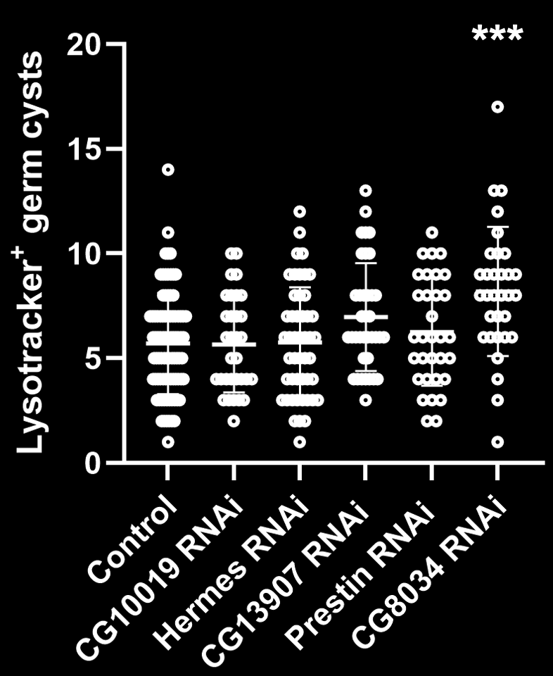
CG8034 is a potential lactate transporter in the somatic cells
Glucose
Pyruvate
?
CG8034
Lactate
Germ cell
- CG8034 knockdown significantly increases germline deaths
Cyst cell
Derived from Dr Diego Sainz de la Maza’s slides

Slide 5
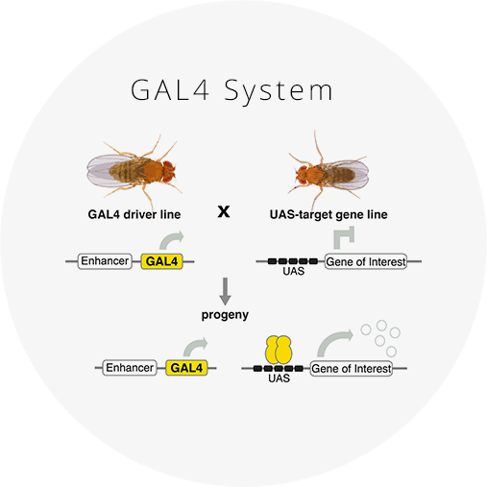
The UAS/Gal4 system
Gal4 – a transcription factor that binds to UAS to activate gene expression
Gal4 promoter – drives Gal4 expression in specific tissue
Examples: Bam-Gal4, Tj-Gal4, etc

Slide 6
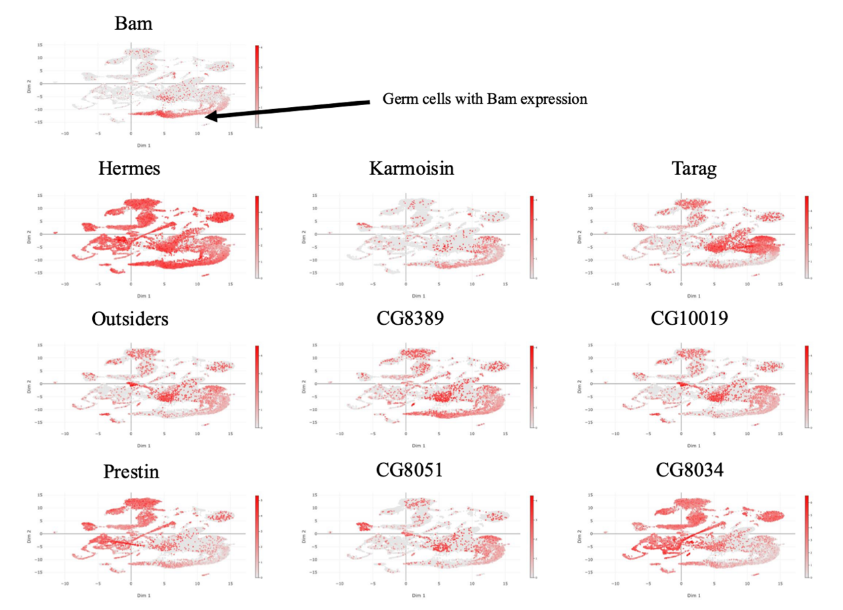
9 MCTs are expressed in the germline
Data from Fly Cell Atlas
UMAP plot scales down multidimensional single-cell RNA-seq data to 2 dimensions
Bam (Bag of marbles) is an early germline marker

Slide 7
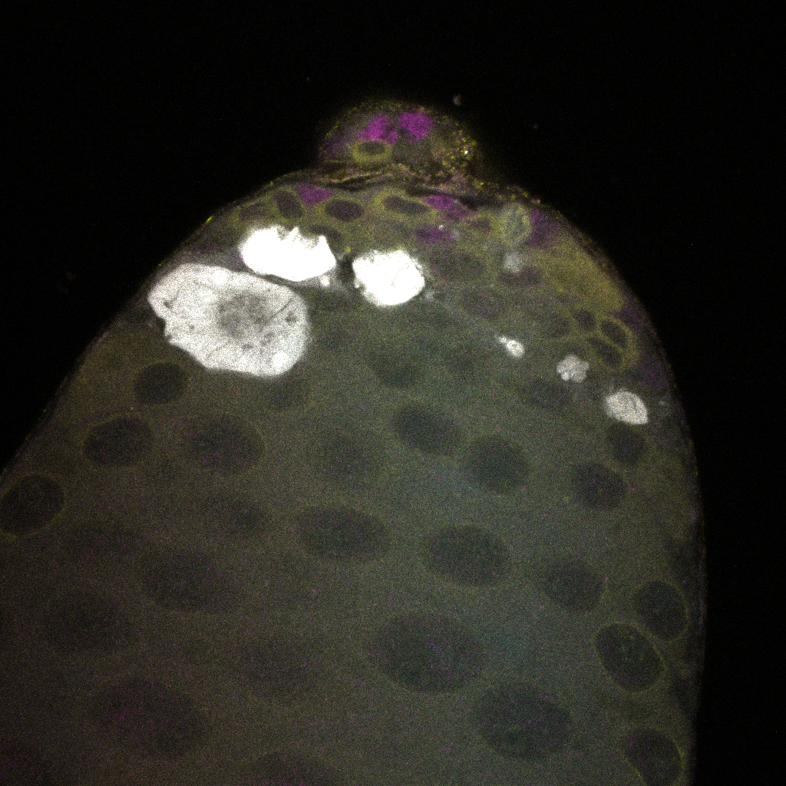
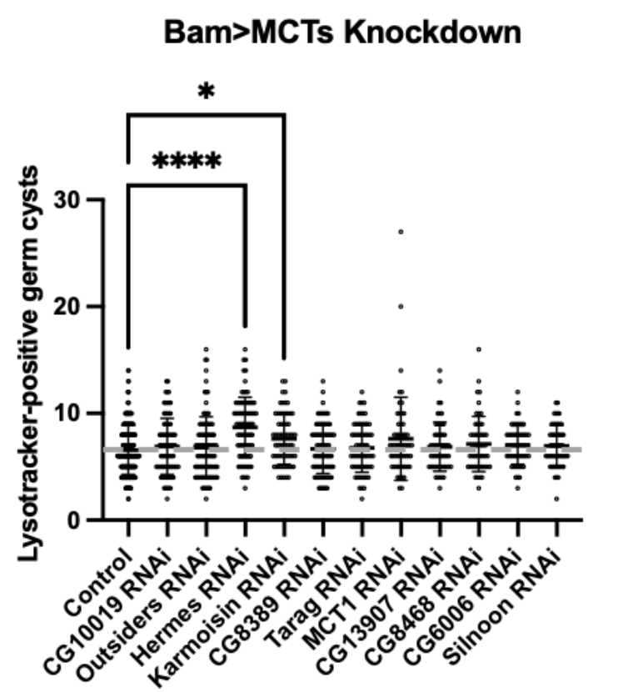
Karmoisin and Hermes Knockdown Increase Germline Death
Karmoisin and Hermes are primarily identified as an aromatic amino acid transporter and a proton-coupled pyruvate transporter, respectively
Further validation using the lactate reporter and a second RNAi line is required

Slide 8

Thank you! Q&A

